Slide 1

Department of Artificial Intelligence and Data Science
Foreign Object Debris Detection and Classification Using Deep Learning
Dr.R.Priyadharshini
Professor
Maiyazhagan V (221801032)
Santhosh V (221801047)
Vaishnavi S (221801059)

Slide 2
Problem Statement and Motivation
FOD causes engine failure, tire bursts, structural damage
Airports face >$4B annual losses due to FOD incidents
Manual inspections are slow, inconsistent, weather-dependent
CCTV/radar fail with small, fast-moving or low-contrast debris
Need automated, accurate, real-time detection system
Ensures 24/7 runway safety and faster response

Slide 3
Existing System
Manual runway patrols and visual inspections
High dependency on human accuracy and lighting
No real-time detection, no hazard identification
Mechanical sweepers cannot detect or classify debris
Radar systems: costly, weather-sensitive, low resolution
Existing CV methods fail in shadows, fog, illumination changes

Slide 4
Objectives
Automate FOD detection using Deep Learning
Classify debris into Living / Non-Living categories
Further classify Non-Living into Hazardous / Non-Hazardous
Integrate YOLOv8, SSD and Faster R-CNN for optimal results
Enable real-time monitoring with GUI and alerts
Ensure robustness under diverse lighting and weather
Reduce human effort and improve runway safety

Slide 5
Abstract
FOD poses major safety hazards in modern aviation
Proposed system uses YOLOv8, SSD and Faster R-CNN
Detects and classifies objects from live runway streams
YOLOv8 → real-time speed; Faster R-CNN → high accuracy
Classifies debris into living/non-living and hazard levels
Enhances safety, minimizes manual dependence
Scalable for continuous 24/7 runway monitoring

Slide 6
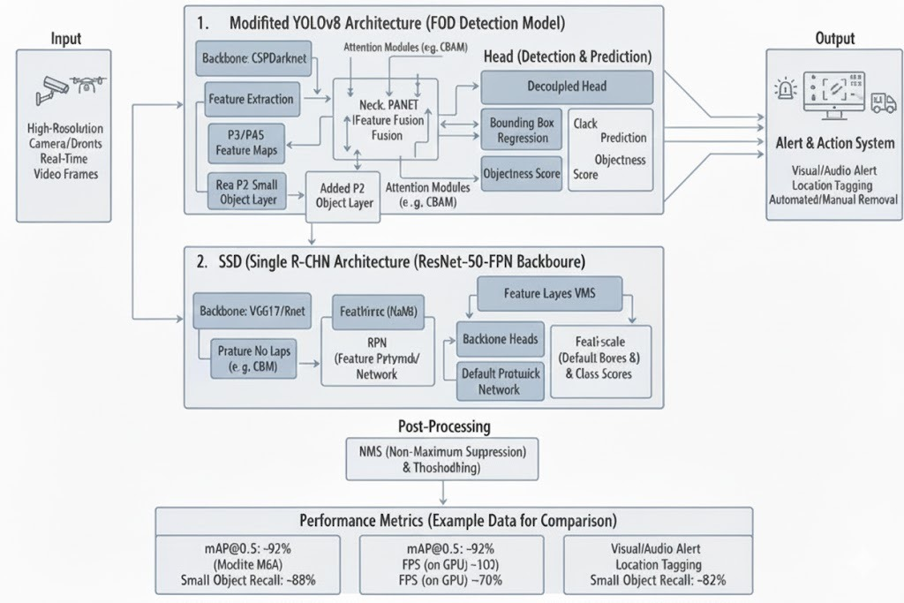
Architecture Diagram

Slide 7
Architecture(framework)
Input Layer: Live runway video/camera feeds
Preprocessing: Resizing, normalization, noise removal
Detection Models: YOLOv8, SSD, Faster R-CNN
Classification Module: Living/Non-living + hazard scoring
Alert Module: Audio-visual warning system
Visualization: GUI with bounding boxes and labels
Storage Layer: Logs detections for reporting & analysis

Slide 8
Module
Dataset Collection: Runway images with varied debris
Data Preprocessing: Resize, augment, normalize
YOLOv8 Module: High FPS, real-time performance
SSD Module: Lightweight, balanced accuracy
Faster R-CNN Module: Small/occluded object accuracy
Hazard Classification: Living / Non-Living / Risk Level
Alert & Visualization: GUI, bounding boxes, alerts

Slide 9
Conclusion
The proposed system successfully automates Foreign Object Debris (FOD) detection on airport runways using deep learning.
Integration of YOLOv8, SSD, and Faster R-CNN provides an effective balance between real-time speed and high accuracy.
The system accurately detects and classifies debris into Living, Non-Living, Hazardous, and Non-Hazardous categories.
The approach significantly reduces manual inspection effort, improves consistency, and ensures 24/7 surveillance capability.
Overall, the solution improves runway safety, reduces operational risks, and offers a scalable framework for modern airport environment

Slide 10
Thank You

